Slide 1
A National Perspective on Community Colleges
The Truman Commission to the Present

Slide 2
Founding Legislation
1862: Morril Act
1907: California (High schools offering postgraduate studies equal to the first two years of college (Vaughan, p.10); 1927,
1921: California passed legislation allowing local control (boards, budgets, operating procedures) which was foundational for creation of other systems in other states.
1920: Founding meeting of AAJC held in St. Louis
1931: Illinois adopts the first Junior College Act
Notes:
George B. Vaughan, The Community College in America: A Short History. Revised. American Association of Community and Junior Colleges, Washington, D.C: ISBN-0-87111-141-4

Slide 3
Higher Education for American Democracy, 1947
Notes:
Morril Act of 1862 is actually the founding document for all education in the United States including community colleges.

Slide 4
The Task of the Commission
"Educational Leaders...felt that somehow the colleges had not kept pace with the changing social conditions, that the programs of higher education would have to be repatterned if they were to prepare youth to live satisfyingly and effectively in contemporary society." (Higher Ed. V1. P.1)
"the numbers of veterans availing themselves of veterans' educational benefits falls short of the numbers that records... show could benefit from higher education" (p.1)
Doubling of the 1947-8 enrollment possible if infrastructure and financial support made available.

Slide 5
Critical Need for Education
Four Major Factors
Impact of technology on society. Impact on interpersonal relations and duties of citizens. New skills and greater maturity needed.
USA made up of the entire world. "Effect democratic reconciliation, so as to make of the national life one continuous process of interpersonal, intervocational and intercultural cooperation." (p.2)
Maintaining peace with the rest of the world (United Nations). "[R]equires of our citizens a knowledge of other peoples...such as has not hitherto been so urgent. (p.2)
Atomic age--"ambivalent promise...underscored the need for education and research for the self-protection of our democracy."

Slide 6
Principal Goals
Education for a "fuller realization of democracy."
Education "directly and explicitly for international understanding."
Education for "application of creative imagination and trained intelligence" for the solution of social problems . (p.8)

Slide 7
Education for All
Lack of educational attainment
1900—250,000 enrolled in higher educational institutions
1947—2,354,000 included one million veterans. (144.1 million)
2021 (fall) 15.4 million (339.9 million)
Financial support--$1,000,000 invested by federal government in 1947 was less than one-half of one percent of the GNP.
Rising tuition, movement away from the "principle of free education." (p.28) Not enough colleges and institutions.
Dependence on individual's cultural and economic status: "the kind and amount of education they may hope to attain depends, not on their own abilities, but on the family or community into which they happen to be born...or, worse still, on the color of their skin of the religion of their parents." (p.27) It is "depriving the Nation of a vast amount of potential leadership and potential social competence which is sorely needs." (p.29)
Notes:
The Commission was focused on the year 1960 and suggested that 4.6 million people would need to be involved in higher education. By 1960, however, only about 3.1 million were enrolled. Rates for primary education, however, reached over 6 million. It would be after Vietnam before the country would see a significant increase in the rates of higher education enrolment.
Issues related to regional support of education—states at the top, California, Washington, Montana, Nevada, Connecticut, New York, Illinois versus Kentucky, North Carolina, Alabama, Arkansas, South Carolina, Mississippi. Discussed "quotas" where schools actively limited the numbers of African American or Jews who could attend the institution.
Civil Rights Act, 1964

Slide 8
Education Without Barriers
"Educational system in which at no level...will a qualified individual in any part of the country encounter an insuperable economic barrier." (p.36)
High school education must be improved
"Tuition-free education should be available...for the traditional 2-year junior college courses." (p.37)
Financial assistance for competent students in 10th through 14th grades (Higher Education Act 1965)
Lowering tuition costs in public controlled colleges
Expand adult education
Public education at all levels equally accessible
Notes:
Army General Classification tests, 10 million. Based upon the results, estimated that 49% of the population had the mental ability to complete the 14th grade. 32% ability to complete an advanced liberal or specialized professional education. This is how they arrived at 4.6 million for 1960

Slide 9
Education Gap

Slide 10
The Community College
"Whatever form the community college takes, its purpose is educational service to the entire community, and this purpose requires of it a variety of functions and programs. It will provide education for the youth of the community certainly, so as to remove geographic and economic barriers to educational opportunity and discover and develop individual talents at low cost and easy access. But in addition, the community college will serve as an active center of adult education. It will attempt to meet the total post-high school needs of its community." (p.68)

Slide 11
Today's College Graduate
"TOO OFTEN [THEY ARE] "EDUCATED" IN THAT [THEY HAVE] ACQUIRED COMPETENCE IN SOME PARTICULAR OCCUPATIONS, YET FALL SHORT OF THAT HUMAN WHOLENESS AND CIVIC CONSCIENCE WHICH THE COOPERATIVE ACTIVITIES OF CITIZENSHIP REQUIRE." (P.48)
COLLEGE MUST FIND THE RIGHT RELATIONSHIP BETWEEN SPECIALIZED TRAINING ON THE ONE HAND, AIMING AT A THOUSAND DIFFERENT CAREERS, AND THE TRANSMISSION OF A COMMON CULTURAL HERITAGE TOWARD A COMMON CITIZENSHIP ON THE OTHER." (P.49)
"IT IS URGENTLY IMPORTANT IN AMERICAN EDUCATION TODAY THAT THE AGE-OLD DISTINCTION BETWEEN EDUCATION FOR LIVING AND EDUCATION FOR MAKING A LIVING BE DISCARDED." (P.61)

Slide 12
Growing the National System
Joliet Junior College (1901) William Rainey Harper and Stanley Brown
1931 Illinois first Junior College Act
1940 12 public junior colleges in Illinois
1947 AAJC enrollment had grown from less than 51,000 in 1927-8 to more than 400,000 in 1946-7 (Higher Ed. V.2, p.8)
Addition of vocational mission. "Such an institution is not well characterized by the name "junior" college." (p.9)

Slide 13
Today's college student is decidedly nontraditional
(College Students Aren't Who You Think They Are By Elissa Nadworny) ​
Financially independent from their parents ​
Having a child or other dependent ​
Being a single caregiver ​
Lacking a traditional high school diploma ​
Delaying postsecondary enrollment ​
Attending school part time ​
Being employed full time ​
​Close to 74 percent of undergrads fall into one of these categories — and about a third have two or three. 17 million Americans enrolled in undergraduate higher education National Center for Education Statistics. ​
1 in 5 is at least 30 years old ​(Fall 2021 37% over 25)
About half are financially independent from their parents ​
1 in 4 is caring for a child ​
47 percent go to school part time at some point ​
A quarter take a year off before starting school ​
2 out of 5 attend a two-year community college ​
44 percent have parents who never completed a bachelor's degree ​

Slide 14
Impact on Attendance
In fall 2021, approximately 10.8 million undergraduate students (70 percent) enrolled at 4-year institutions and 4.7 million undergraduate students (30 percent) enrolled at 2-year institutions.
At 4-year institutions,7.9 million (73 percent) attended full time; and
2.9 million (27 percent) attended part time.
At 2-year institutions,1.6 million (35 percent) attended full time; and
3.0 million (65 percent) attended part time.
(https://nces.ed.gov/programs/coe/indicator/csb/postsecondary-students)

Slide 15
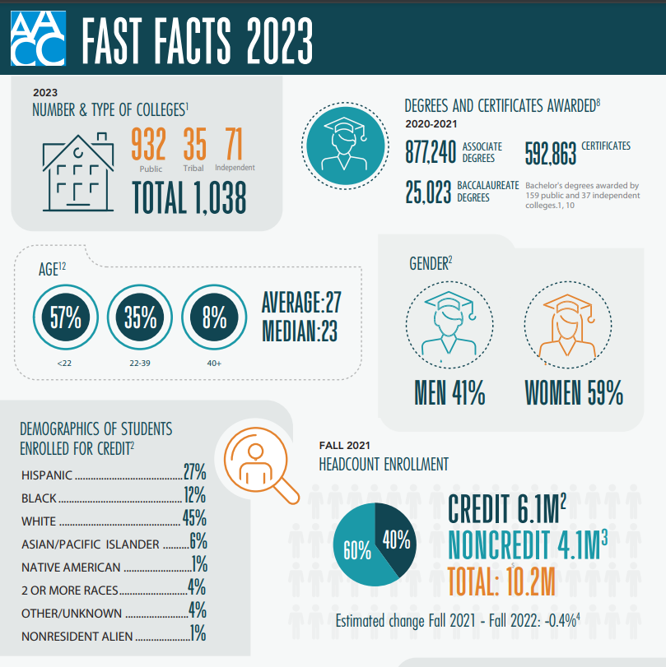
Where We Are Today

Slide 16
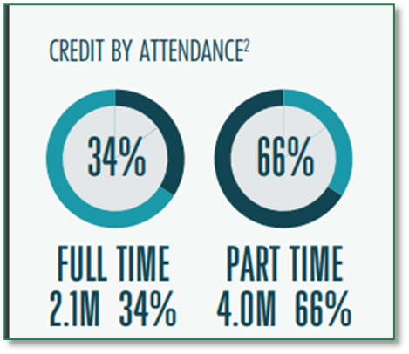

Slide 17
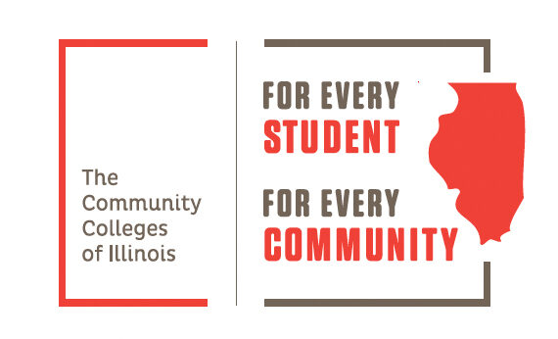
STUDENTS ARE COMING. BUT. . . how EFFECTIVE are COMMUNITY COLLEGES?

Slide 18
How do we measure effectiveness?
How should we measure success?

Slide 19
Access and Success
Community College 1.0 – ACCESS through ENROLLMENTS
+
Community College 2.0 – ACCESS + COMPLETION
+
Community College 3.0 – ACCESS + COMPLETION + POST GRADUATE SUCCESS

Slide 20
Community College 1.0
ACCESS – DIVERSITY in ENROLLMENTS

Slide 21
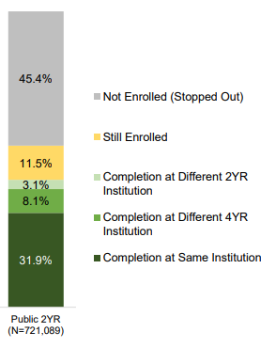
Community College 2.0 COMPLETION
Six-Year Outcomes: 2016 Cohort
43%
Taken from https://nscresearchcenter.org/wp-content/uploads/Completions_Report_2022.pdf

Slide 22
Leaky Pipeline
College-level Math and Writing
Dev Ed
2nd semester
Graduation
3rd semester
4th semester
Plugging the Holes

Slide 23
Guided Pathways
Equitable student success
On-time graduation
https://southseattle.edu/guided-pathways

Slide 24
But…. completion is not enough
Students do not go to college to complete degrees
Not all degrees are created equal
Some degrees don’t have independent value
Opportunities upon completion may not be equitable
Adapted from Michael Gutierrez, President, Sacramento City College

Slide 25
Community College 3.0 Post-Graduation Success: Equity Outcomes
https://fineartamerica.com/featured/i-graduated-now-im-smart-and-stuff-college-graduate-sourcing-graphic-design.html
https://ingenium.engr.tamu.edu/you-graduated-without-a-job-offer-now-what/

